Slide 1
FTTx Architecture
FiberONE Technical Academy ©

Slide 2
Module 1
Fiber to the X fundamentals
Module 2
FTTX Network Architectures
Module 3
Capacity planning and Management

Slide 3
Module 1
Fiber to the X fundamentals
The history and future of fiber to the X- Gigabit Revolution !!
The world is evolving into a global digital society and this is profoundly transforming the way we live, work, learn and thrive.
About 15 to 20 years ago, home and business internet connections were pretty slow. Downloading a single image would take hours. And, since the internet was usually
accessed via telephone lines ( ADSL,DSL : Copper Lines , you’d have to choose between
making a phone call and using the internet—you couldn’t do both at the same time.
However . The arrival of Broadband Technology changes that forever, with Fiber Technology it
was possible to transmit information over multiple channels simultaneously. Data could be sent and received over the long-awaited, multi-lane “information superhighway”—
using just one cable.
a EPON a GPON a XG-PON a NG-PON2

Slide 4
Module 1
Fiber to the X fundamentals
Fiber To The X (FTTx) - The X Generics
Fiber To The X (FTTx) refers to a series of broadband network architectures that use optical Fiber to replace all or part of the usual metal local loop used for last-mile telecommunications.
Fiber To The X (FTTx) is a technology model in modern telecommunications, representing the future of high-speed internet access, also to significantly enhances data transmission speeds and reliability compared to traditional copper or coaxial cable networks
Fiber to the x (FTTX) is a generic term for any broadband network architecture.
The “X” in FTTx can be replaced by various letters indicating the extent of the fiber’s reach, such as:

Slide 5
Module 1
Fiber to the X fundamentals
X Series : NGA
The ‘X’ in ‘FTTx’ represents a particular object. It could be a home, a cabinet or any end-user premise
FTTH (Fiber to the Home): Fiber reaches the individual residences.
FTTB (Fiber to the Building/Basement): Fiber reaches the building or the basement of multi-dwelling units, with the final connection to individual units made using copper or coaxial cables.
FTTC (Fiber to the Cabinet/Curb): Fiber reaches a street cabinet or curb, and the connection to homes or businesses is completed using existing copper wires.
FTTP (Fiber to the Premises): A general term that includes both FTTH and FTTB.
FTTN (Fiber to the Node/Neighborhood): Fiber reaches a local telecommunications node, with the final connection made using copper cables.

Slide 6
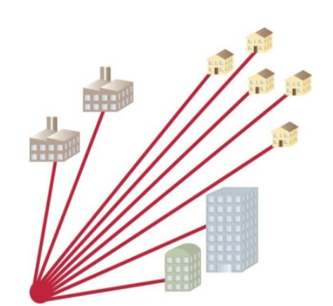
Module 1
Fiber to the X fundamentals
Topology And Technology
FTTx Network Topology & Architecture
Active Optical Network is a point-to-point network structure in which each subscriber has its Fiber-optic line terminated on an optical concentrator. AON network covers electrically powered switching equipment, such as a router or a switch aggregator, to manage signal distribution and direction signals to specific customers
Point-to-Point (P2P): Each subscriber is connected directly to the central office or an Optical Line Terminal (OLT) via a dedicated Fiber link.
No sharing of bandwidth; each user has their own Fiber path. It has its own advantages and disadvantages.

Slide 7
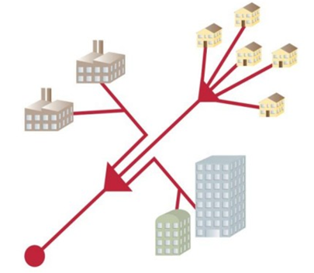
Module 1
Fiber to the X fundamentals
FTTx Network Topology & Architecture
Point-to-MultiPoint (P2MP): In Fiber to the X (FTTx) deployments, Point-to- Multipoint (P2MP) topology is widely used to efficiently distribute Fiber connectivity to multiple end-users.
It refers to a network topology where a single source (such as OLT) connects to multiple endpoints (such as ONUs) using shared infrastructure. The focus is on the connection structure rather than the technology used.
Passive Optical Network (PON): A P2MP topology that utilizes passive optical components like splitters to distribute the signal from the OLT to multiple ONUs.
PON utilizes passive optical splitters that do not require power, allowing a single fiber strand from the central office to serve multiple end-users.

Slide 8
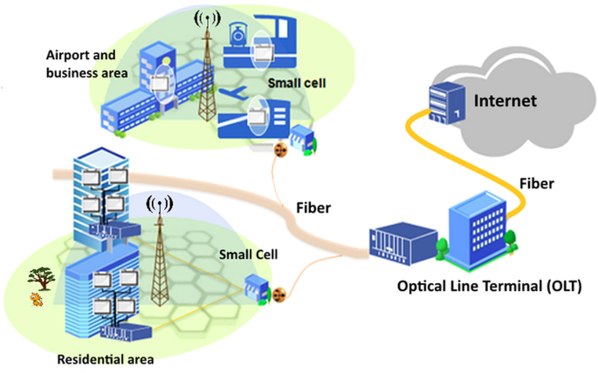
Module 1
Fiber to the X fundamentals
Class Assessment :
What is Fibre to the X?
What are the different types of FTTx?
What is the difference between FTTX vs FTTH?
What is meant by G-PON?
What is NGA ??

Slide 9
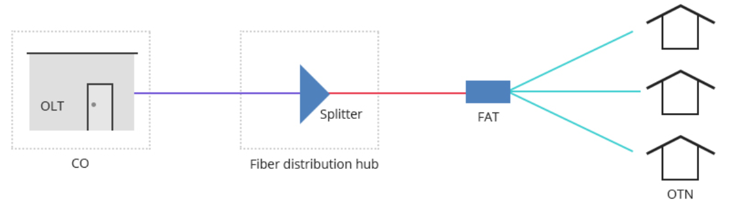
Module 2
FTTX NETWORK ARCHITECTURES
Cable Architecture
Fiber Optic Cabling for FTT-x Network
For the NGA, it is very imperative to have a proper and scalable foundation cabling for a robust network One of the start points for a capacity management on a good foundation is architectural planning or design of cabling structure at the foundational level; there are three main FTTx fiber cables implementation and design to build up FTTx networks:
b Feeder cables b Distribution cables, b Access /drop cables

Slide 10
Module 2
FTTX NETWORK ARCHITECTURES
FTT x Cabling as a Promising Future Technique?
FTTx Architectural cabling is future-promising because it owns the unique characteristics to which other techniques can not compare and meet the users’ current and possible future needs.
First of all, it is related to the trend that the access and backbone bandwidth requirements are expected to continue to grow rapidly for the next months or even years.
FTT x Cabling as a Promising Future Technique?
It is Scalable
Cabling Arch planning is cost effective

Slide 11
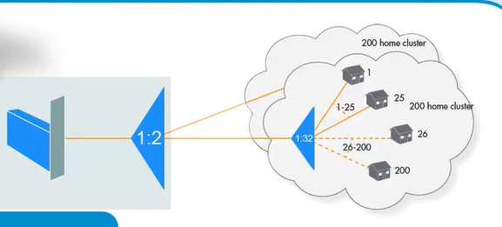
Module 2
FTTX NETWORK ARCHITECTURES
Outside Plant Components Architectural planning for FTTx Network
In order to get more clarity on FTTx cabling, it is important to know the components in the FTTx network design
OLT: Optical line terminal in a PON system, located in the central office (CO) or hut, is the interface to the subscriber and provides the subscribed services.
ONU: Optical network unit, used to convert optical signals via fiber to electrical signals.
Splitter: Passive device that splits the light source in sperate paths in a PON system.
Architectural planning Factors :
A Total Home Passed A Clusters a Capacity Distribution

Slide 12
Module 2
FTTX NETWORK ARCHITECTURES
PON system
A PON system, or Passive Optical Network, is a fiber-optic network that uses unpowered devices to deliver internet connectivity to multiple users.
How it works
A PON system uses a single fiber from a service provider to deliver broadband to multiple users
The system uses optical beam splitters to distribute a single signal to multiple branches
It is "passive" because it doesn't require electricity to distribute the signal
It consists of an optical line terminal (OLT) at the service provider's central office and optical network units (ONUs) near the users
PON systems are commonly used by internet service providers (ISPs) to deliver fiber to the home FTTx generics
PON systems is cost effective for commercial environments
Benefits
PON systems can transmit data at speeds of up to 100 Gbps
PON systems are less susceptible to interference than traditional networks

Slide 13
Module 2
FTTX NETWORK ARCHITECTURES
PON system
With PONs, power is only required at the source and receiving ends of the signal. Data is separated and collected by unpowered optical splitters along the line. It should be noted that PONs share fiber strands only for portions of the network.
Splitter-based FTTx architectures: Centralized and Distributed Split Comparison
Centralized Splitting (One-time Splitting)
Advantages | Disadvantages
Standard based | Costly entry point cabinet required
cost savings over a P2P architecture | tape splicing adds labor intensive cost and compexity
centralized cabinet for management of cables, splicing and terminating | taper splicing requires detailed record keeping separate mapping and increases design time and cost
interconnection panel gives operator flexibility | higher fiber count cables required exiting the cabine
A splitter port and dedicated fiber for ever subscriber | requires mid-span entry technique for larger count fibers for cable access, increased time due to management of remaining cables

Slide 14
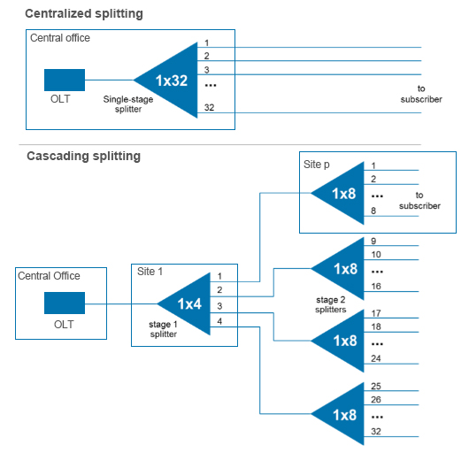
Module 2
FTTX NETWORK ARCHITECTURES
Distributed Splitting (Cascading Splitting)
Advantages | Disadvantages
Flexibility in split ratios in serving area | Removes the dedicated fibres from each subscriber back to a centralized point
Reduces splitter cabinet requirements | Eliminates the advantage of having all the interconnections at the point
 | Increases network complexity without the benefit of reducing overall fiber count

Slide 15
Module 3
Capacity planning and Management
FTTx Capacity planning and Management FOR Next Generation Access
FTTx capacity planning and management involves
Predicting demand, selecting technologies, and managing resources to maximize network capacity.
FTTx stands for Fiber to the X, and it's a network architecture that delivers broadband services to homes and businesses
Some characteristics of next-generation networking
SD-WAN –
Automation
AI
Wi-Fi 6E

Slide 16
Module 3
Capacity planning and Management
FTTx Capacity planning and Management FOR Next Generation Access
Next Generation Access (NGA) network planning involves designing and deploying new or upgraded networks that offer improved broadband speeds and quality of service.
Planning : NGAs can be wired access networks that use optical elements, such as fiber-to-the-home
Quality of service : NGA required minimal latency for effiencies
Capacity and connectivity : NGAs required robust capacity and connectivity in the backhaul network.
Independent provisioning : NGAs should use distributed, open control mechanisms to promote competition.
Benefits of NGAs
NGAs can provide unfettered access to networks and competing service providers.

Slide 17
Module 3
Emerging Trends in FTTx Deployments
Rapidly Expanding Internet User Base
Surging Demand for Video Content: Over 90% of internet traffic coming from video content
Rise of Smart Homes and IoT: The Internet of Things (IoT) has transformed the way we interact with our surroundings. From smart thermostats to connected security systems
Statista forecasts that there will be over 75 billion connected IoT devices by 2025, indicating the need for robust and high-speed internet connections to support seamless connectivity and communication between these devices.
Increased Rural Connectivity:
One of the key trends in FTTx deployments is the effort to bridge the digital divide by extending fibre connectivity to rural areas. Traditionally, rural regions have had limited access to high-speed internet due to the high costs and difficulties in infrastructure deployment. However, advancements in technology and government initiatives are now driving the expansion of FTTx networks to underserved areas:
Rural communities are benefiting from increased access to online educational resources, telehealth services, and economic opportunities.

Slide 18


